Slide 1


Slide 2
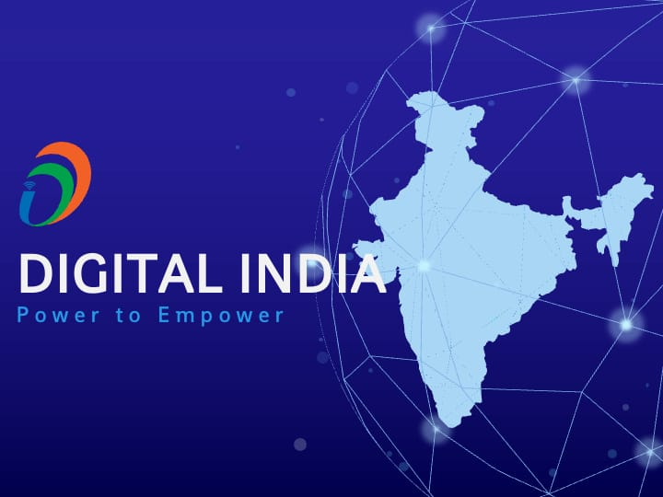
🚀 Digital India
Empowering Nation Through Vibrant Technology, Connectivity & Digital Literacy
NAME:
CHANDRA (261072)
NISHASNT (261061)
HARI (261071)
KANAHAIYA (261068)
Computer Science & Engineering/ B.TECH sec. B

Slide 3

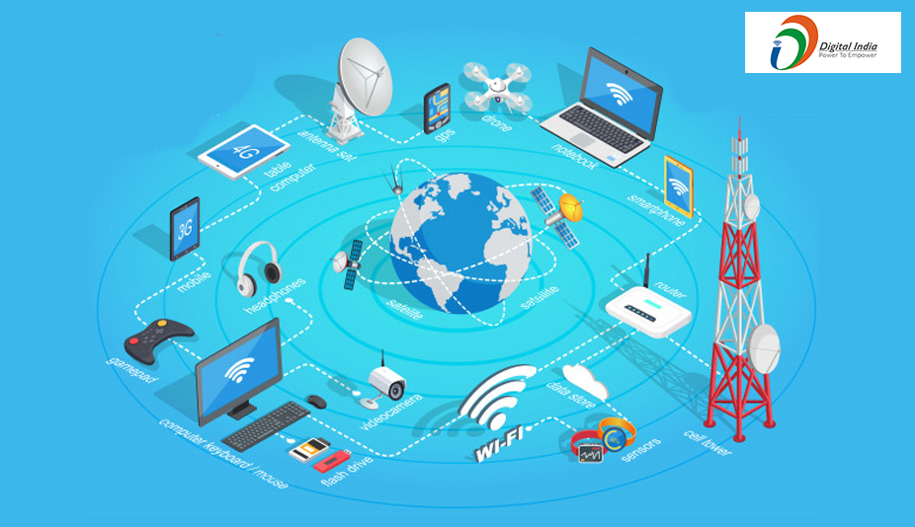


🌟 Introduction to Digital India
✨
What is it? A visionary campaign launched by the Government of India to transform the nation into a digitally empowered society and robust knowledge economy.
✨
Vision: Providing digital infrastructure as a core utility to every citizen, ensuring governance & services on demand.
✨
Core Pillars: Focuses on broadband highways, public internet access, and universal e-Governance.

Slide 4






🏗️ Pillars of Digital Transformation
Digital Infrastructure
Governance on Demand
Digital Empowerment
High-speed internet connectivity across rural and urban regions, ensuring high-speed broadband highways reaching every nook and corner.
Seamless integration of government departments making real-time public services immediately available online to every single citizen.
Universal digital literacy, equal access to digital learning repositories, and widespread secure adoption of cashless payment ecosystems.

Slide 5
💡 Key Transformative Initiatives
Aadhaar (UIDAI): Providing a secure 12-digit biometric unique identity platform linked directly to financial and public services.
UPI & Digital Payments: Revolutionizing micro-transactions and peer-to-peer payments with world-leading real-time transaction volumes.
DigiLocker: A secure cloud-based platform for issuing, storing, and authenticating official academic and government certificates digitally.
PMGDISHA: Empowering rural households with digital literacy to bridge the technological divide completely.

Slide 6
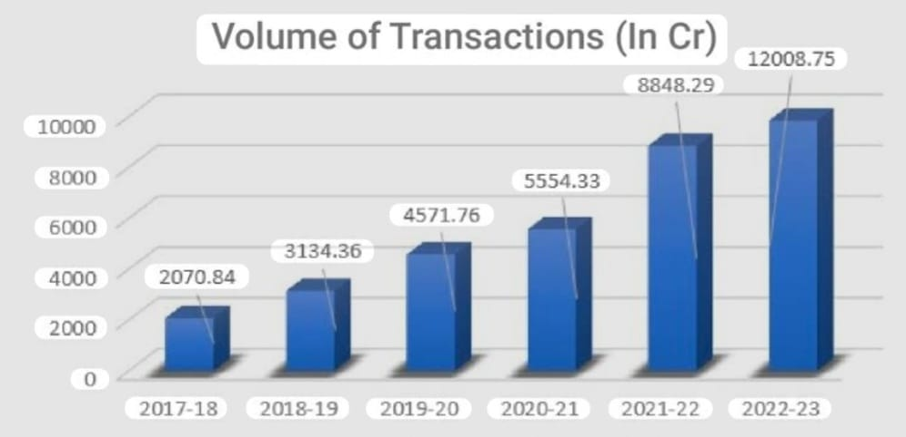

📈 Explosive Growth in Transactions
130B+
Redefining Financial Inclusion
India leads the global digital payment revolution. The Unified Payments Interface (UPI) handles billions of transactions effortlessly every single month, empowering street vendors and major corporations alike.
Annual UPI Transactions

Slide 7
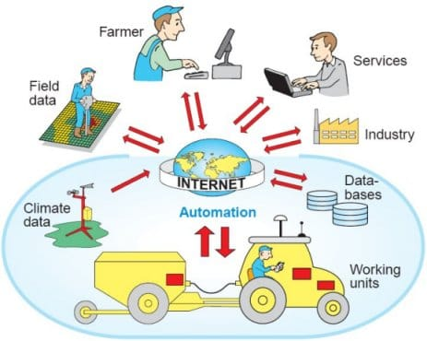


🌍 Real-Life Sector Impact
Healthcare & Education
Agriculture & Direct Benefits
Platforms like DIKSHA for interactive online schooling and eSanjeevani for virtual telemedicine bring top-tier medical care and expert lessons straight to rural households.
Direct Benefit Transfer (DBT) ensures government subsidies reach beneficiary bank accounts instantly without leakage, while e-NAM connects farmers directly to national marketplaces.

Slide 8
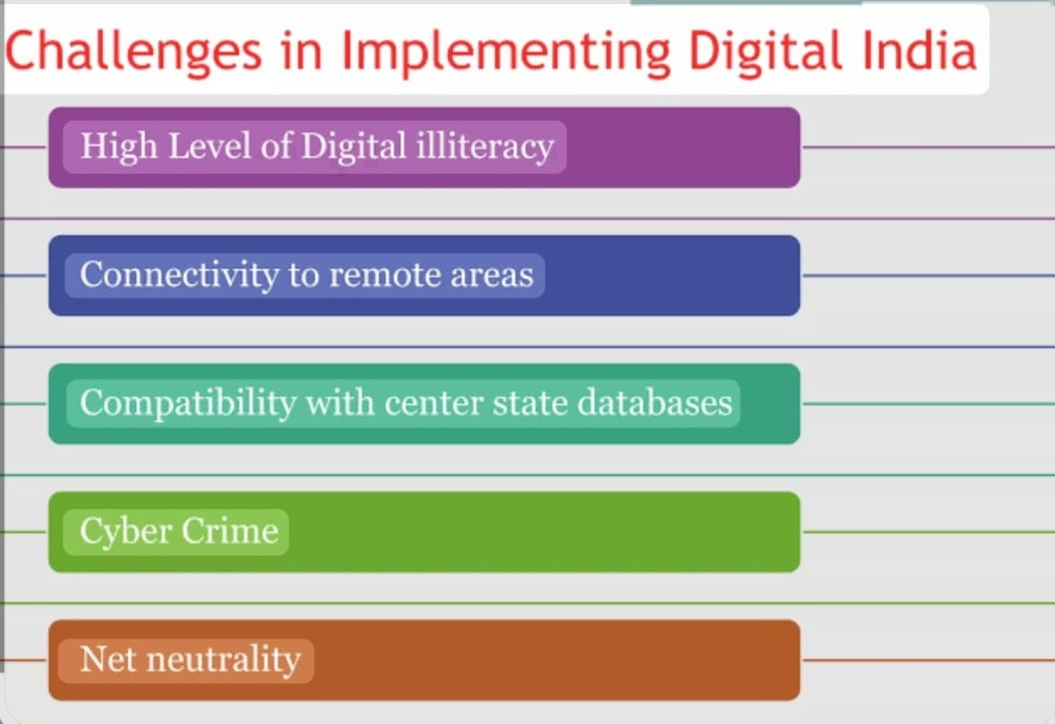

🛡️ Challenges & Consultation
Addressing cybersecurity, rural digital gaps, data privacy, and expert consultation for a secure future.

Slide 9


💡 Expert Consultation & Way Forward
Strategic Recommendations
Future Vision & Policy
• Cybersecurity Enhancement: Implement rigorous decentralized encryptions and continuous AI-driven security auditing across all public portals.
• Rural Infrastructure Boost: Accelerate last-mile fiber optics deployment to remote tribal belts to achieve 100% true broadband parity.
• AI Integration: Embed multilingual AI chatbots into e-governance apps to help illiterate citizens navigate digital welfare schemes easily.
• Data Privacy Enforcement: Strict adherence to data protection laws to cultivate ultimate user trust in digital governance.

Slide 10
📊 Digital Adoption Growth Metrics
Internet Users (Millions)
Smartphone Penetration
Active Broadband Connections

Slide 11
📚 References & Sources
Source Type | Title / Detail | Author / Platform
Official Portal | Digital India Initiative Overview & Objectives | MeitY, Government of India
Financial Report | Monthly UPI Ecosystem Performance Report | National Payments Corporation of India (NPCI)
Research Article | Digital Transformation and Socio-Economic Impact | World Economic Forum Insights

Slide 12

🎉 Thank You!
Do you have any questions or feedback regarding Digital India?
Under the guidance of :
Mrs. AASTHA KASHYAP
Assistant Professor , Department of CSE

